Slide 1
Automobile Charge station Analysis and Prediction
Team
-Vishnu Sudireddy
-Sreekar Thanda
-Nagateja Ravilla
-Sai Vishwak Jadala

Slide 2
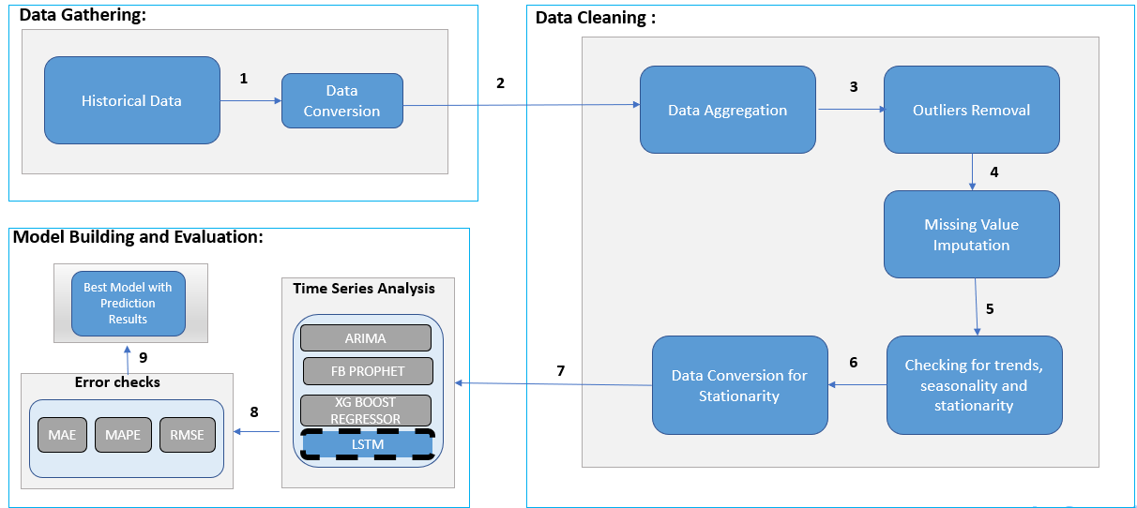
METHODOLOGY

Slide 3
FEATURES
Historic data Analysis: Keeps the track of previous data such as number of charging sessions per day and consumption of the electricity at the station.
Real time data monitoring: It provides the insights of current demand and usage pattern.
Predictive modelling: Predict the future demand of the charging stations.
Network optimization: Measuring the performance and area of potential improvements are found like future load required at the stations is found.

Slide 4
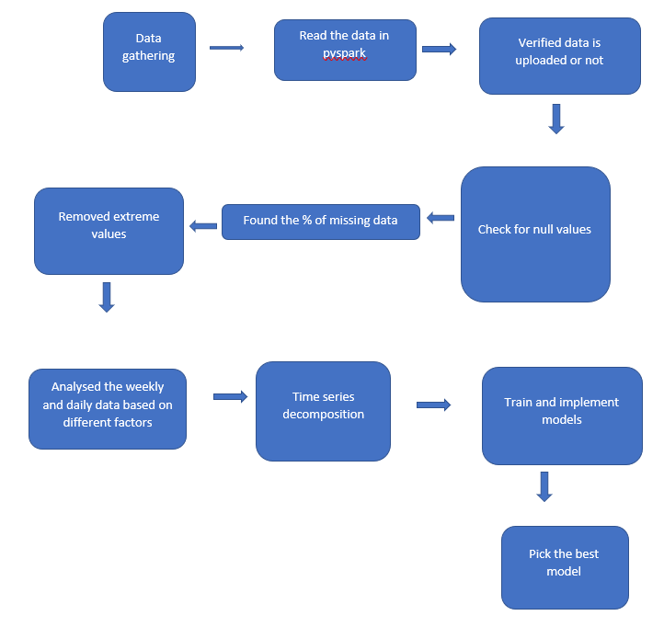
WORKFLOW

Slide 5
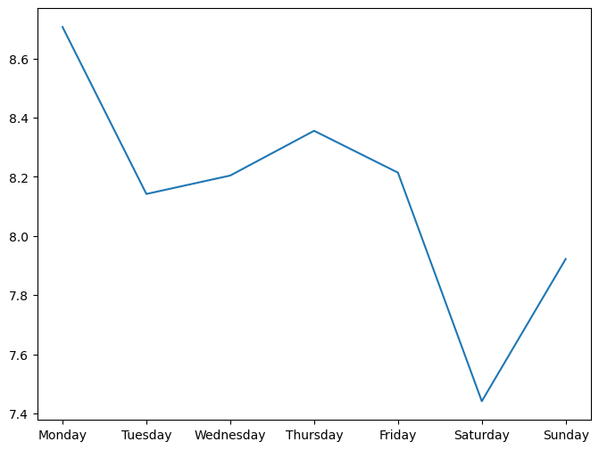
IMPLEMENTATIONS

Slide 6
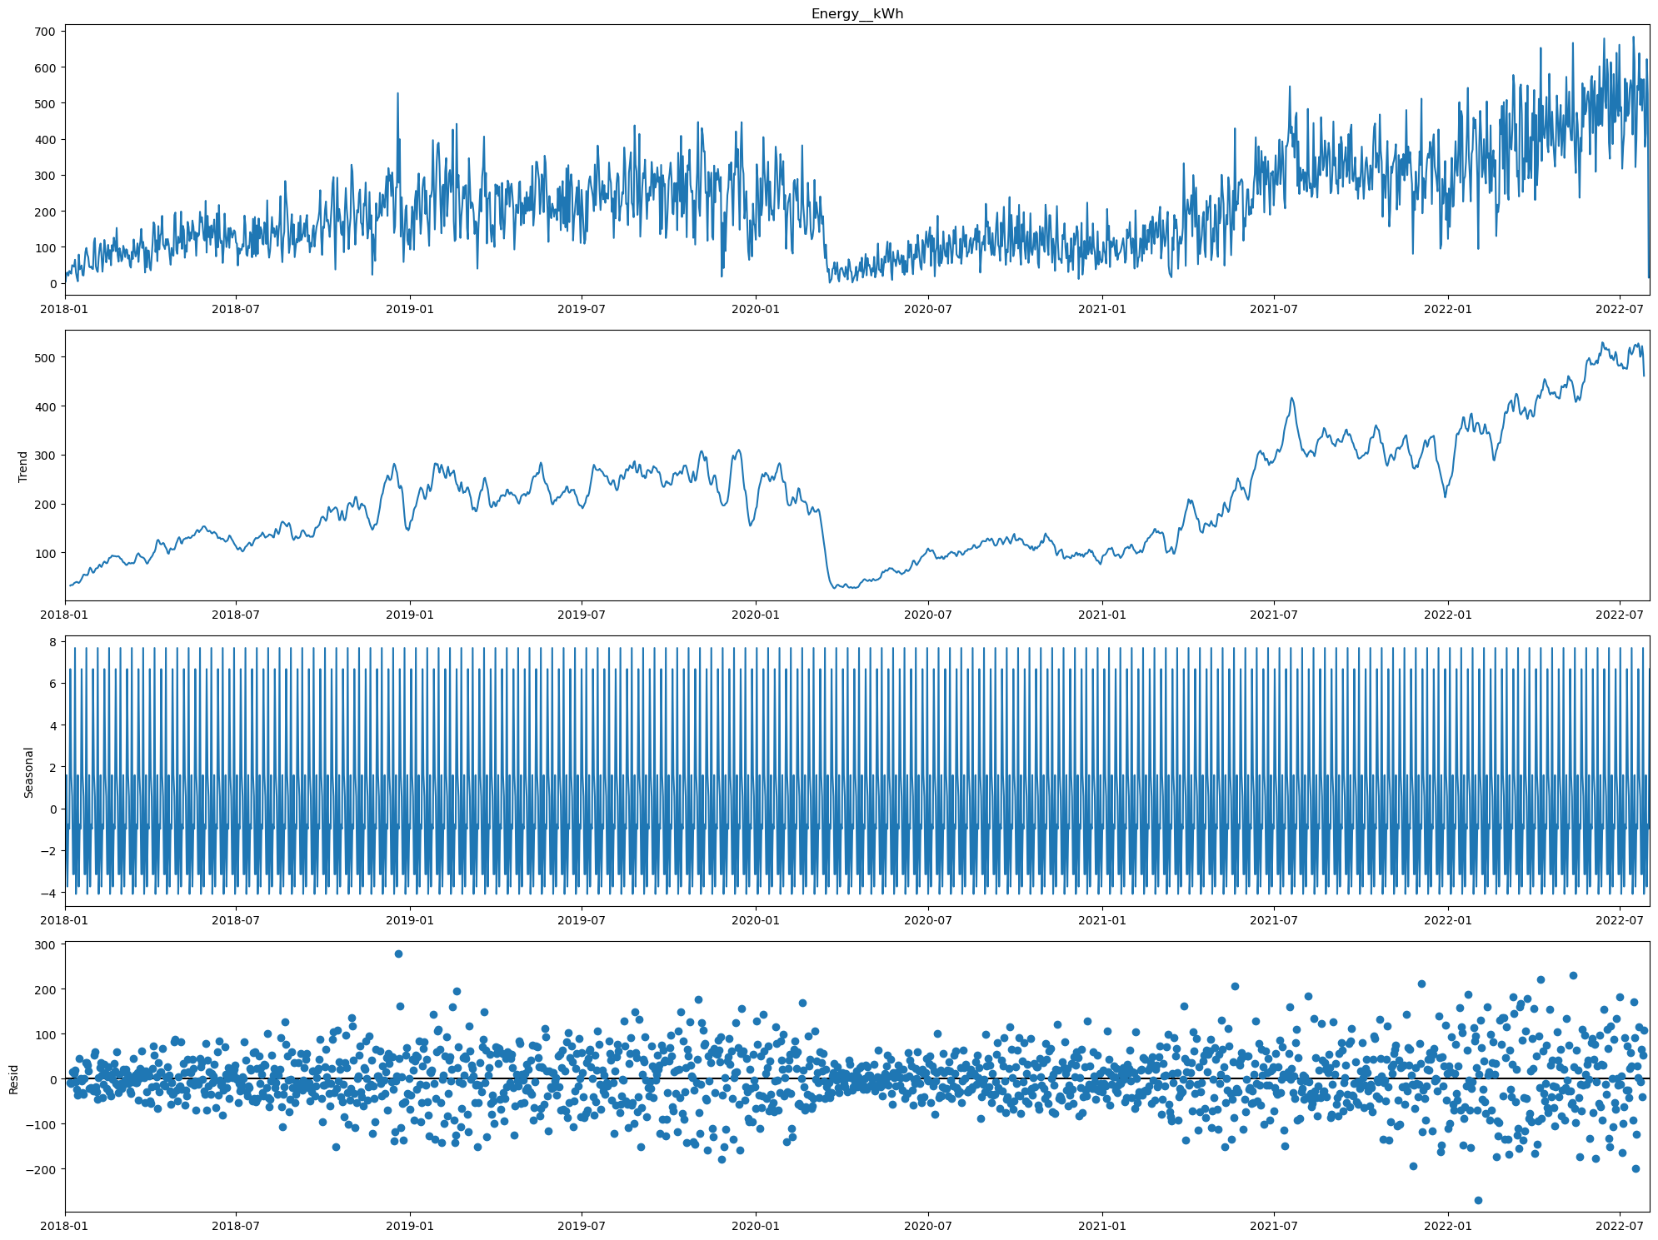
IMPLEMENTATIONS

Slide 7
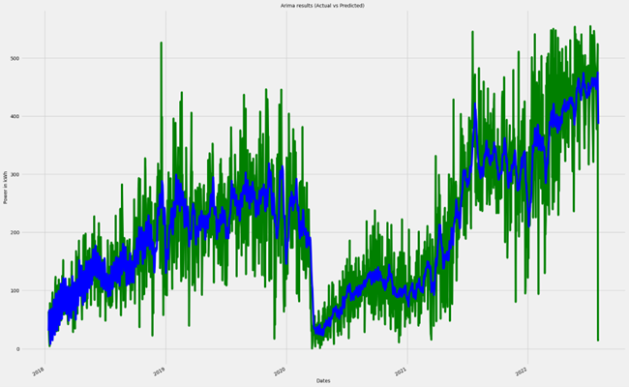
Arima model result

Slide 8
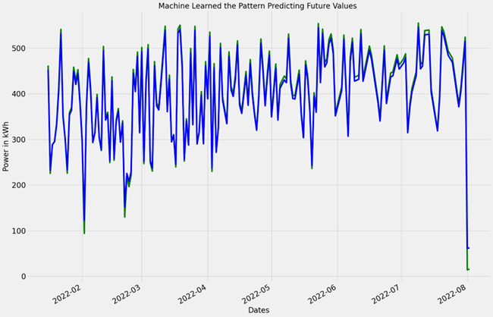
LSTM model result

Slide 9
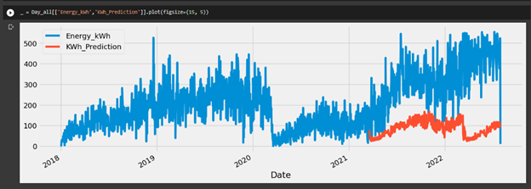
XG Boost regression

Slide 10
Responsibilities
Responsibilities took by Sreekar Thanda are Data gathering and Pre-processing and building ARIMA model.
Data Cleaning and work on LSTM model is done by Vishnu Sudireddy.
Vydya Abhiram worked on plotting the data and finding the dependencies and worked on LSTM model in identifying the best epoch and optimizer combination.
Sai Vishwak worked on XGBoost model and ARIMA model.

Slide 11
THANK YOU

